Slide 1
Design Pattern
(Object Oriented Programming → Part 1)
Name: Sheikh Thanbir Alam
Deg: Senior Software Programmer
Org: Army War Game Center, BD Army

Slide 2


What is OOP?
OOPs or object oriented programming is not something that you need. It is just an approach. It is way to analyse and design solutions of a problem.

Slide 3
Principles of OOP
Class.
Object.
Method and method passing.
Pillars of OOPs.
Encapsulation.
Inheritance.
Polymorphism.
Abstraction.
Compile-time polymorphism.
Runtime polymorphism.

Slide 4


Class
Constructor
Destructor

Slide 5

Lets create a “Virtual Console Robot”
Head (int)
HeadMaterial (string)
Eye (int)
EyeMaterial (string)
Hand (int)
HandMaterial (string)
Leg (int)
LegMaterial (string)
CanRun (Boolean)
CanFight (boolean)
CurrentLocation (string)

Slide 6
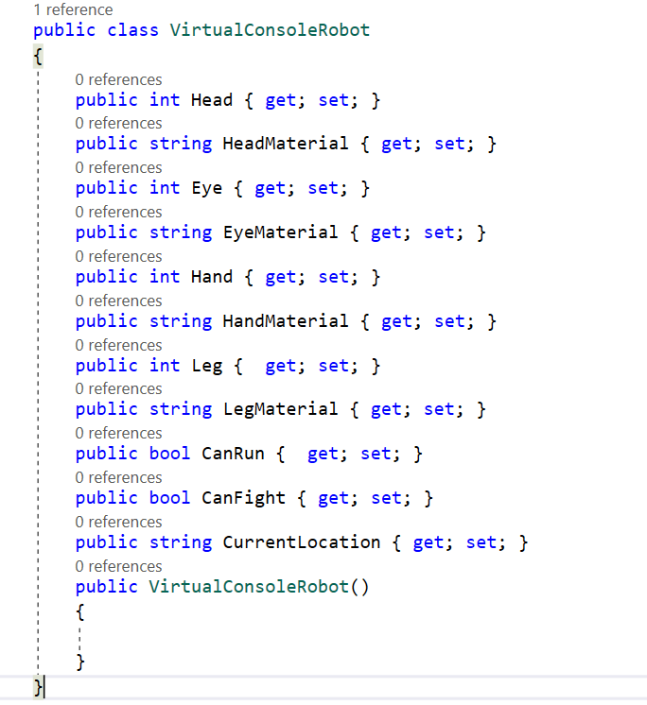
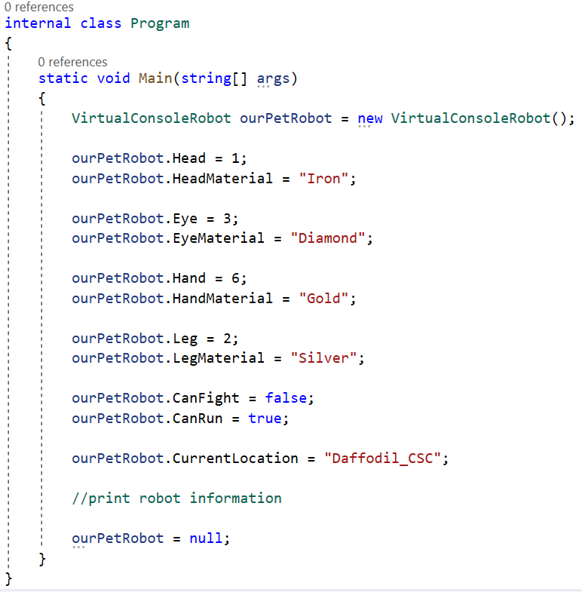
Notes:
//Main Class
VirtualConsoleRobot ourPetRobot = new VirtualConsoleRobot();
ourPetRobot.Head = 1;
ourPetRobot.HeadMaterial = "Iron";
ourPetRobot.Eye = 3;
ourPetRobot.EyeMaterial = "Diamond";
ourPetRobot.Hand = 6;
ourPetRobot.HandMaterial = "Gold";
ourPetRobot.Leg = 2;
ourPetRobot.LegMaterial = "Silver";
ourPetRobot.CanFight = false;
ourPetRobot.CanRun = true;
ourPetRobot.CurrentLocation = "Daffodil_CSC";
//print robot information
ourPetRobot = null;
//VirtualConsoleRobot
public class VirtualConsoleRobot
{
public int Head { get; set; }
public string HeadMaterial { get; set; }
public int Eye { get; set; }
public string EyeMaterial { get; set; }
public int Hand { get; set; }
public string HandMaterial { get; set; }
public int Leg { get; set; }
public string LegMaterial { get; set; }
public bool CanRun { get; set; }
public bool CanFight { get; set; }
public string CurrentLocation { get; set; }
public VirtualConsoleRobot()
{
}
}

Slide 7
Do it now!
Send your robot to India.
Now,
Create another class name as “EnemyConcoleRobot”
Populate data from main class.

Slide 8
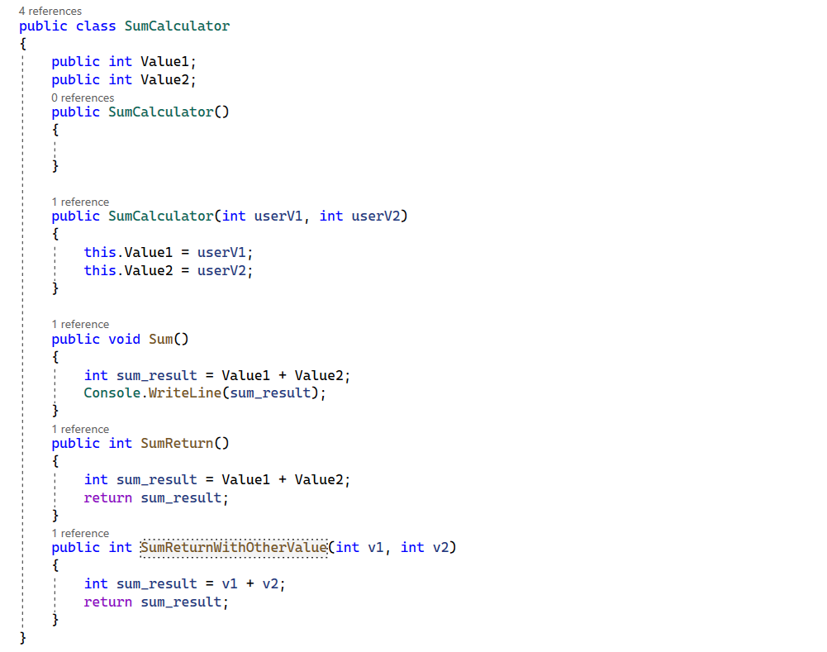
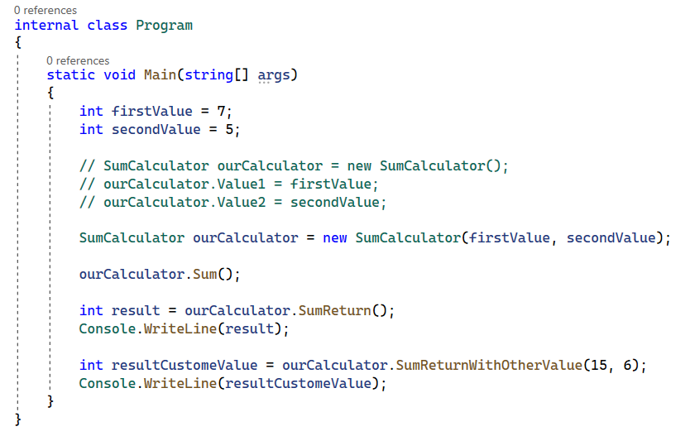
Function / Method
Notes:
//Sum Calculator
public class SumCalculator
{
public int Value1;
public int Value2;
public SumCalculator()
{
}
public SumCalculator(int userV1, int userV2)
{
this.Value1 = userV1;
this.Value2 = userV2;
}
public void Sum()
{
int sum_result = Value1 + Value2;
Console.WriteLine(sum_result);
}
public int SumReturn()
{
int sum_result = Value1 + Value2;
return sum_result;
}
public int SumReturnWithOtherValue(int v1, int v2)
{
int sum_result = v1 + v2;
return sum_result;
}
}
//Main Class
static void Main(string[] args)
{
int firstValue = 7;
int secondValue = 5;
// SumCalculator ourCalculator = new SumCalculator();
// ourCalculator.Value1 = firstValue;
// ourCalculator.Value2 = secondValue;
SumCalculator ourCalculator = new SumCalculator(firstValue, secondValue);
ourCalculator.Sum();
int result = ourCalculator.SumReturn();
Console.WriteLine(result);
int resultCustomeValue = ourCalculator.SumReturnWithOtherValue(15, 6);
Console.WriteLine(resultCustomeValue);
}

Slide 9


